Slide 1

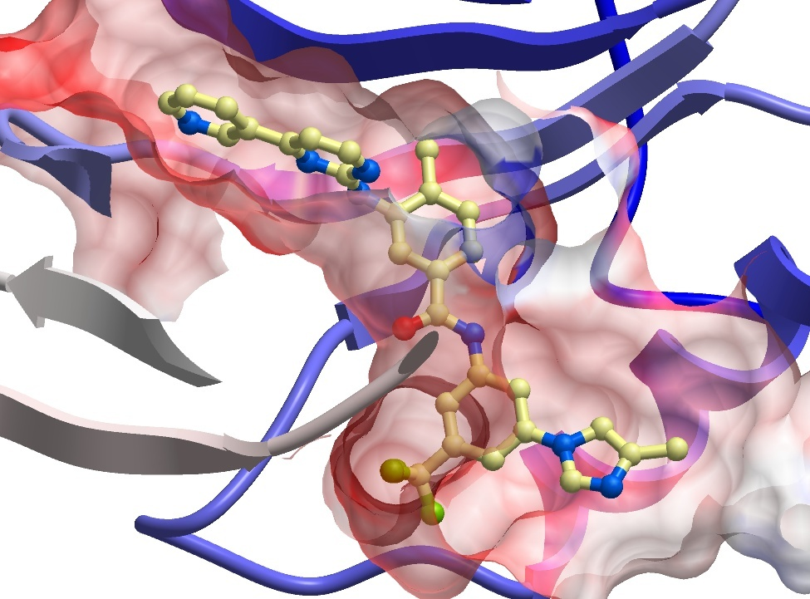






Solubility Testing of 14 compounds by DLS
Sumera Perveen
Molecular Biophysics
SGC Toronto
March 26th, 2024
SGC Frankfurt
SGC KI
SGC Neuro
SGC Toronto
SGC UNC

Slide 2
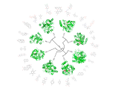

Testing 4 DENV NS5 compounds by DLS
Solubility of 4 DENV NS5 compounds (Plate AViDD2196) were tested by DLS (DynaPro DLS Plate Reader III) from 6.3µM to 25µM, in filtered 25mM Tris pH 7.5, 1mM MgCl₂, and 2mM MnCl₂, 0.5% glycerol, 2% DMSO, at 25ºC, in duplicate.
Buffer with 2% DMSO control produced laser power of 100%, and an average intensity of 583 kCounts/s.
The compounds are ranked according to increasing intensity values at 25µM.
Compound Name | ChemiReg ID | Normalized Intensity (kCnt/s) |  |  | Laser Power (%)
 |  | 6.3µM | 12.5µM | 25µM | 6.3µM | 12.5µM | 25µM
RA-0003318-01 | HL004314b | 937 | 639 | 592 | 100 | 100 | 100
RA-0020066-01 | HL004327a | 984 | 1038 | 1157 | 100 | 95 | 90
RA-0003301-01 | HL004325a | 629 | 1104 | 1358 | 100 | 100 | 100
RA-0003272-01 | HL004326a | 1461 | 1511 | 2206 | 100 | 85 | 75
Molecular Biophysics

Slide 3

ACKNOWLEDGEMENTS
Molecular Biophysics
SGC Toronto
Experiments in this report were performed by:
Irene Chau
Compound Management:
Albina Bolotokova
www.thesgc.org
FUNDING PARTNERS
The Structural Genomics Consortium is a registered charity (no: 1097737) that receives funds from Bayer AG, Boehringer Ingelheim, Bristol Myers Squibb, Genentech, Genome Canada through Ontario Genomics Institute [OGI-196], EU/EFPIA/OICR/McGill/KTH/Diamond Innovative Medicines Initiative 2 Joint Undertaking [EUbOPEN grant 875510], Janssen, Merck KGaA (aka EMD in Canada and US), Pfizer and Takeda.

